Slide 1


Weekly Report NTUA 27/3/2020
George Bakas

Slide 2
Status Report
Analysis:
New Method for extracting Nqcd in signal region
Fit not possible because 0btag and 2btag QCD have very different shapes
Unfolding
Result of the fit has a small deviation regardless the method we are using
Signal Extraction--> Unfolding to parton or particle level and comparison with 2016 paper results
Measured dist from data
QCD shape taken from MC
$$S\left(x_{reco}\right)=D\left(x_{reco}\right)−N_{QCD, reduced}^{(2)}C_{QCD}^{shape}\left(x_{reco}\right)Q\left(x_{reco}\right)−B(x_{reco})$$
Fiducial Yield
ABCD Method
QCD shape correction factor
Subdominant bkg shape and contribution (MC)

Slide 3
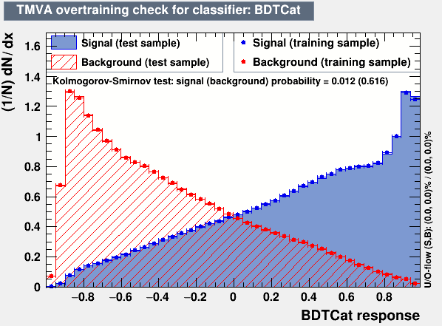

Workaround
For selecting a Control and Signal Region we apply the following:
Signal Region
Basic Selection
Medium b-tagging WP
Top Tagger Cut ( > selected WP1)
Control Region
Basic Selection
NOT Loose b-tagging WP
NOT Top Tagger Cut ( < selected WP2)
CR Selection
SR Selection
Both jets TopTagged + Both jets !B-tagged A | Both jets TopTagged + Both jets B-tagged (Signal Region) C
Both jets !TopTagged + Both jets !B-tagged B | Both jets !TopTagged + Both jets B-tagged D
Top tagged
C = $\frac{A}{B}D$
B tagged

Slide 4
Unfolding Parton

Slide 5
Unfolding Particle

